Slide 1
YAHTZEE!
CUP O’ JAVA
Hunter Banks
Connor King
James Vuong

Slide 2
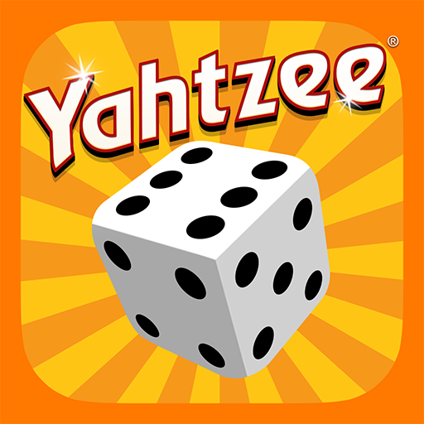
Project Overview
Game of Yahtzee with up to 8 players
Ability to configure:
Number of players
Player Names
Players can reroll their hand
Players can view their scorecard when needed
Players can choose which scoreline to use their hand on
Limitations:
Time
Code basing/implementation
Assumptions:
Rules are understood by players
Players understand how to work a computer
Notes:
James

Slide 3
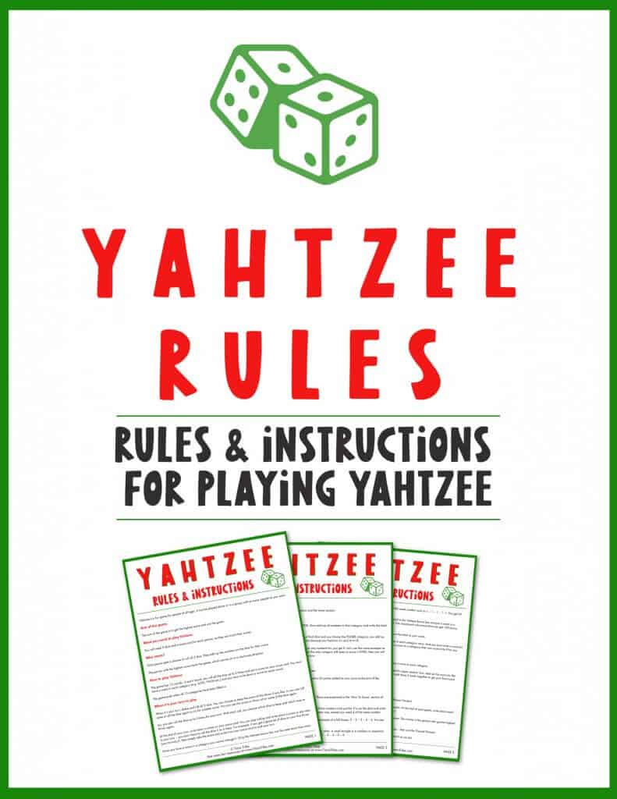
Project Requirements
Play an accurate game of Yahtzee, true to the game rules
Game will be true to the official Hasbro rules
Allows for multiple users to play in a single game
At the beginning of game, the user will choose between 1-8 players to participate
Game is played on a graphical user interface (GUI)
All of the game elements will be completed using the GUI. No console information will be needed.
Notes:
Connor

Slide 4
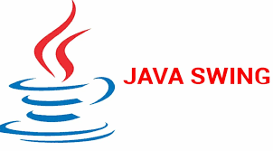
Project Solution Approach
MAJOR COMPONENTS:
GUI Class
Player Class
Yahtzee Game Class
GAME/GUI FOCUSES:
Solo vs. Multiplayer Configuration
Displaying Correct Player Names/Turns
Making it look Pretty
Notes:
Connor

Slide 5
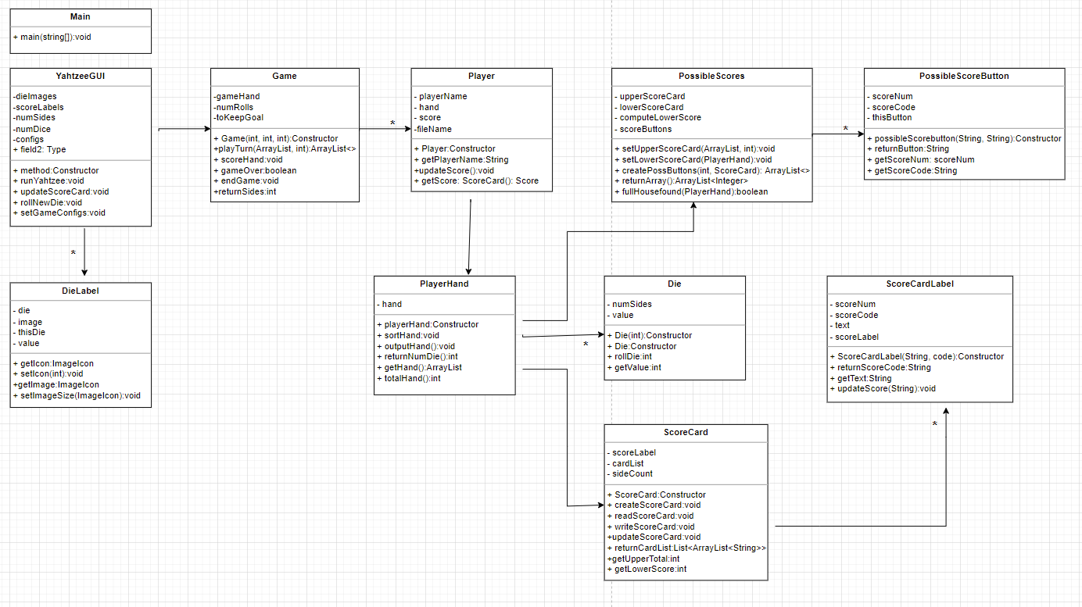
UML Design
Notes:
james

Slide 6
Team Collaboration Approaches
Our team communicated using Slack which worked pretty well. Slack also allowed us to see when the GitHub repo was updated with automatic messages.
We didn’t use GitHub as much as we initially planned. This was because we did group sessions where we would meet and code on one computer.
We learned that branching and merging can be difficult when we are all trying to work on the same task. Our final project was built off one of our HW4’s, so the act of just implementing multiplayer was difficult to perform with different branches.
Notes:
Hunter

Slide 7
Testing, Validation, and Acceptance Plan
Unit Testing:
Lower scorecard
Upper scorecard
Hand generating
Integration Testing:
GUI displays
Game flow
Functional Testing:
GUI button functionality
Acceptance Testing:
Letting our roommates/friends play our Yahtzee!
Notes:
Hunter

Slide 8
Demo Time!!
Notes:
James Laptop

Slide 9
Summary
In conclusion, one of the biggest takeaways was how difficult GUI programming can be. No task was a simple task.
We learned about difficulties with using GitHub branching and merging, and where these tools can be more or less helpful in different scenarios.
Communication was our biggest friend.
It was a difficult, but rewarding experience since we hadn’t worked on group coding projects before.
Notes:
all

